Slide 1
Portfolio Analysis: Introduction
Office of Portfolio Analysis
Division of Program Coordination, Planning, and Strategic Initiatives
National Institutes of Health

Slide 2
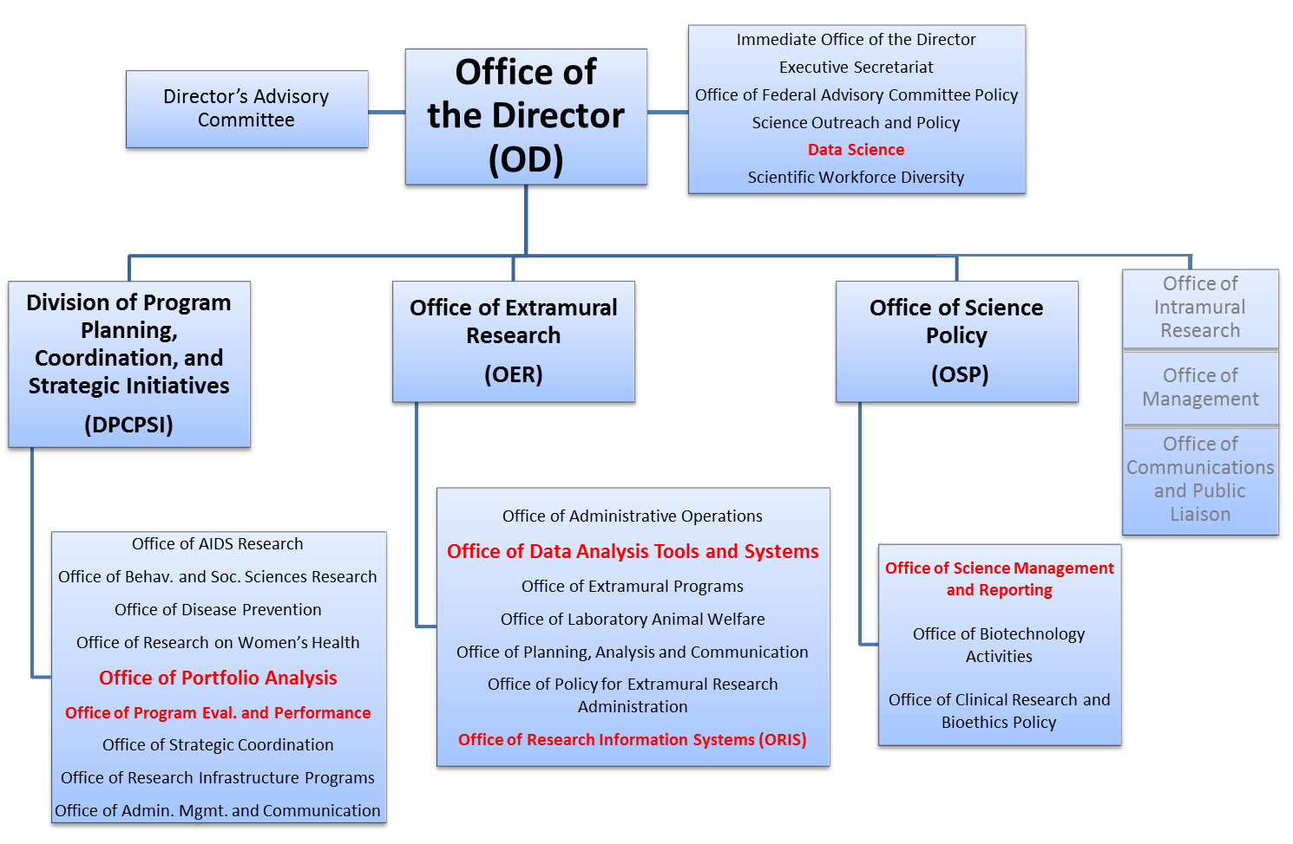

Slide 3
Office of Portfolio Analysis
Director – Dr. George Santangelo
Established in 2011
OPA Mission Statement:
Our purpose is to enhance the impact of NIH-supported research by enabling NIH research administrators and decision makers to evaluate and prioritize current, as well as emerging, areas of research that will advance knowledge and improve human health.

Slide 4
Mission of the Office of Portfolio Analysis
Coordination of trans-NIH portfolio analysis activities
Conducting NIH-wide analyses for the NIH Director and DPCPSI Director
Planning and hosting Workshops, Symposia, and Seminars
Creating opportunities for crosstalk within the NIH community
Portfolio Analysis Interest Group (PAIG) and blog (The Analyst)
Consultation
Assisting NIH staff in the 27 Institutes and Centers (ICs) with analyses
Has resulted in collaborative development of tools, case studies, etc.
Training
Both formal classes and ad hoc sessions
OPA web site: user manuals, FAQs, instructional videos (under construction)
Developing a science of portfolio analysis
Building new tools / approaches and augmenting pre-existing ones
Primary focus is biomedical research
Building a community of experts: government, academia, private sector
Office of Portfolio Analysis

Slide 5
Why do we Carry out Analyses?
Office of Portfolio Analysis

Slide 6
Why are portfolio analyses carried out?
In response to questions from senior leadership or external requests
Strategic planning and Program management
Evaluation
Exploration and discovery
Office of Portfolio Analysis

Slide 7
What questions can we ask?
Office of Portfolio Analysis

Slide 8
Types of Analyses
Content Analysis
What is being done?
How much is being spent?
Is there overlap?
Has the science changed?
Network Analysis
Who is working with who?
Who is being funded by who?
Impact Analysis
What is being published and who is citing the work?
Is there any IP (patents, licensing etc.)?
New clinical guidelines?

Slide 9
What is the investment in a certain area?
Official NIH spending reported using RCDC
Not all topics are reportable categories
Total investment in “your favorite area” including intramural (2007-2010 only), and extramural awards.
Office of Portfolio Analysis

Slide 10
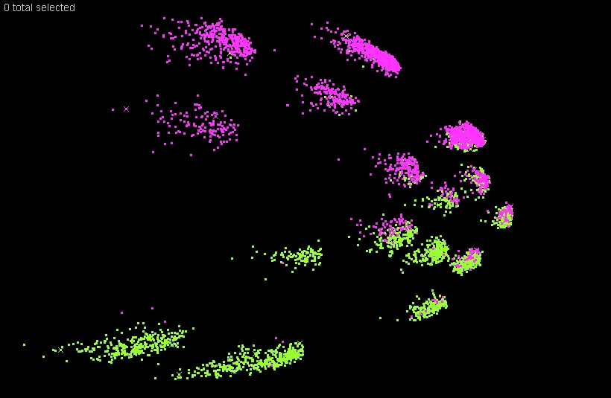
Is there overlap between agencies/ICs/divisions?
1
2
3
5
4
6
7
9
8
14
10
11
16
13
12
15
20
17
18
19
IC (b)
IC (a)

Slide 11
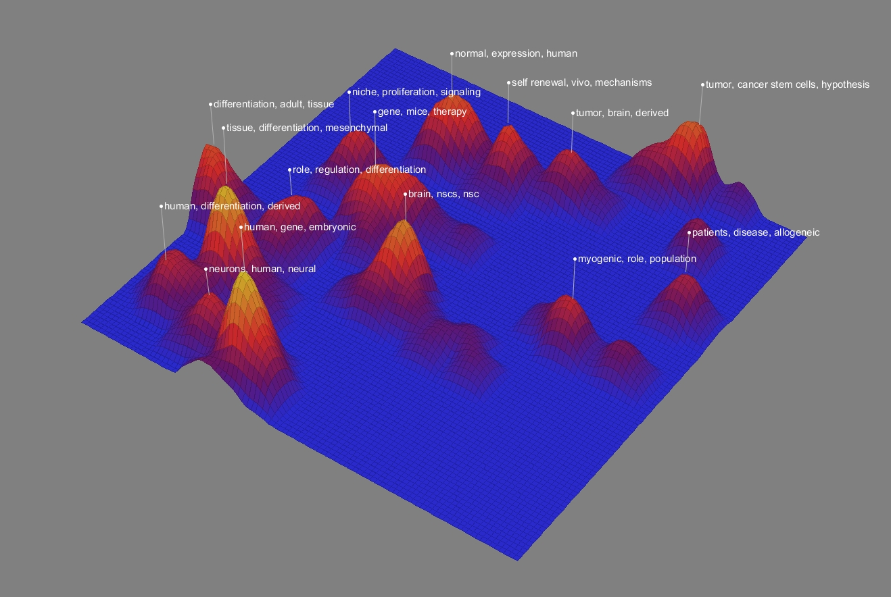
Evolution of Portfolios: Stem Cell Research
291 Projects
2009
Searched QVR for “Stem Cell” in Title and Abstract

Slide 12
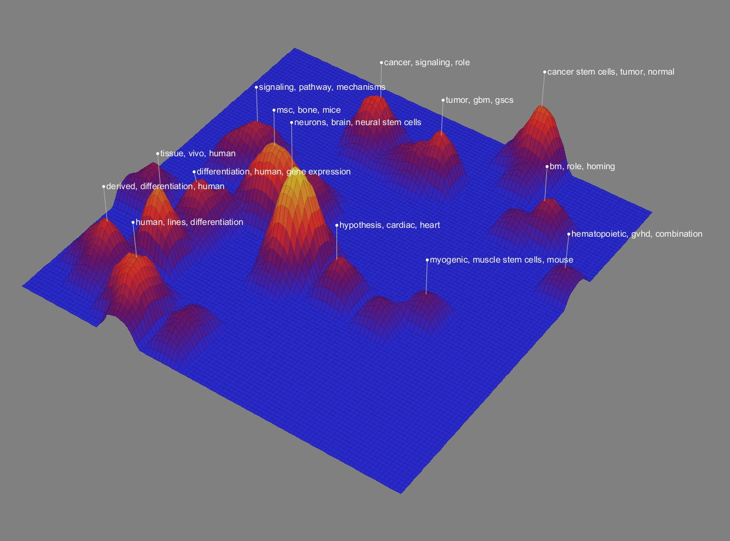
193 Projects
2013

Slide 13
Is there collaboration in my field?
USA
Europe
Japan
FY09 Metabolomics Co-authorship Networks
Notes:
OPA analysis of 38 Metabolomics Centers in the US, most of which receive funding from NIH (~$70M in 2010)
These Centers have overlapping goals, yet operated in isolation with little coordination or collaboration
Portfolio analysis shaped a new Metabolomics RFA aimed at improving coordination and leveraging existing resources

Slide 14
How influential are publications?
NIH-funded research
INPUT
Publications
OUTPUT
INFLUENCE
Citations

Slide 15
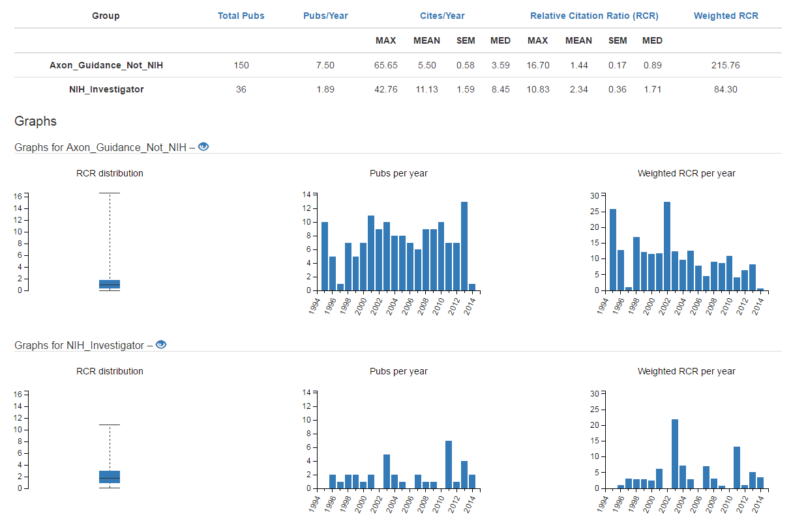
How influential are publications?
Random sample
of non-NIH axon
guidance papers
NIH-funded
investigator studying
axon guidance

Slide 16
How do we get started?
Office of Portfolio Analysis

Slide 17
The Basics
Define the question you are trying to answer
Define the data you are going to use
Identify the tools you are going to use
Office of Portfolio Analysis

Slide 18
Step 1: Define your question
The Basics: Part One
Office of Portfolio Analysis

Slide 19
What is the question you are trying to answer?
Start general and then get specific
How will the analysis be used?
Who will the analysis be shown to?
ALWAYS have a question
Office of Portfolio Analysis

Slide 20
Step 2: Define your datasets
The Basics: Part Two
Office of Portfolio Analysis

Slide 21
What data are you going to use?
Office of Portfolio Analysis

Slide 22
Gathering data
 | Data | When to use | Details
iSearch | NIH and HHS grants, global grants, publications, patents, clinical trials, and approved drugs | For analysis | isearch@od.nih.gov https://od.lexicalintelligence.com/dashboard
QVR | NIH and HHS grants, and publications | Grants management | Inside.era.nih.gov
Reporter | NIH funded grants, publications, some patents | For the public | Reporter.nih.gov
http://inside.era.nih.gov/files/Activity_Code_Book.pdf
Office of Portfolio Analysis

Slide 23
iSearch
Fast
Highly tuned document indexes provide subsecond query time over millions of funded and unfunded grants, tens of millions of publications, tens of millions of patents, and hundreds of thousands of clinical trial and drug records.
Comprehensive
Data consist of over 4 million funded and unfunded NIH grant applications from 1975 to the present and approximately 3 million non-NIH grant records from over 200 agencies; 26 million publications; 11 million patents, 223,000 clinical trials, and 32,000 approved drugs.
Easy-to-use
Google-like free text queries, NIH-specific search filters, and real-time drill down make data exploration quick and accurate.

Slide 24
iSearch
Expressive
Free text search supports a full range of boolean, phrase, proximity, exact, and wildcard searches over a number of customizable search fields.
Flexible
Numerous combinations of search fields and filters make it possible to find answers to complex questions quickly. Search grants with approved drugs, find patents by grant number, filter publications by admin IC, limit grants by number of publications, export search results directly to iCite.
Up-to-date
Nightly jobs clean and link the latest IMPACII data with publications and patents. Clinical trials are added daily. Publications, patents, drug approvals and RCR values are updated monthly.

Slide 25
iSearch – Grants Data
NIH, CDC, SAMHSA, AHRQ, HRSA, VA, FDA, OASH, ADAMHA, ACF
Funded and unfunded applications from IMPACII
1975 – present
Updated daily
Non-NIH grants
Approximately 3 million funded applications from ~230 agencies
1952 – present (depending on agency)
Updated monthly
Data cleaning
Remove boilerplate text (e.g., “Provided by applicant”, “In the space provided”) that interferes with content-based analyses and document clustering
Normalize non-standard characters for improved searching
Remove non-printing characters for more consistent text processing

Slide 26
iSearch – Patent Data
iSearch – Publication Data
26 million publications
All of PubMed
Updated monthly
Linked to grants – spires match case 5, 4, and “3.5”
Match case 3.5
Spires match case 3 + name of author matches name of grantee
E.g., “Willman, Cheryl L” -> “Cheryl Willman” or “CL Willman”
11 Million patents
USPTO
Weekly updates
Linkages
Automatically recognize grant number variants in the federal support section and description
Substantially increases the number of patents attributable to NIH grants

Slide 27
iSearch – Clinical Trials Data
223,000 Clinical trials
Clinical trials.gov
Updated daily
Linked
Citations in Clinical Trials
Links in IMPACII
iSearch – Approved Drugs
32,000 approved drugs
FDA Orange book
Updated monthly
Linked drugs to patents, patents to grants
Linked Patent Use Code to indication for easy searching

Slide 28
Who can use iSearch?
iSearch is designed for extramural staff at the NIH. NIH log-in and QVR credentials are required to access iSearch. For access to iSearch or requests for additional details, please contact isearch@od.nih.gov

Slide 29
Exercise Searching for Publications
iSearch
Fast, interactive grant search
Export to OPA web apps to gather publication data and analyze
https://od.lexicalintelligence.com/dashboard
Office of Portfolio Analysis
Notes:
Next QVR class is on April 2nd, is on how to use the Cart feature.

Slide 30
Step 3: Clean your Data
Missing data
Is there data for all the fields you are interested in?
Need a minimum of Title and Abstract to do content analysis
Ambiguous data
Names
Individuals – problems with attribution of authorship
Departments – useful for defining fields?
Institutions – many ways to refer to the same place
Allow enough time to gather and clean the data
Data cleaning:
Comprehensive and accurate data
Opportunity to become familiar with the data
Approximately 90% of the time is spent at this part of the analysis

Slide 31
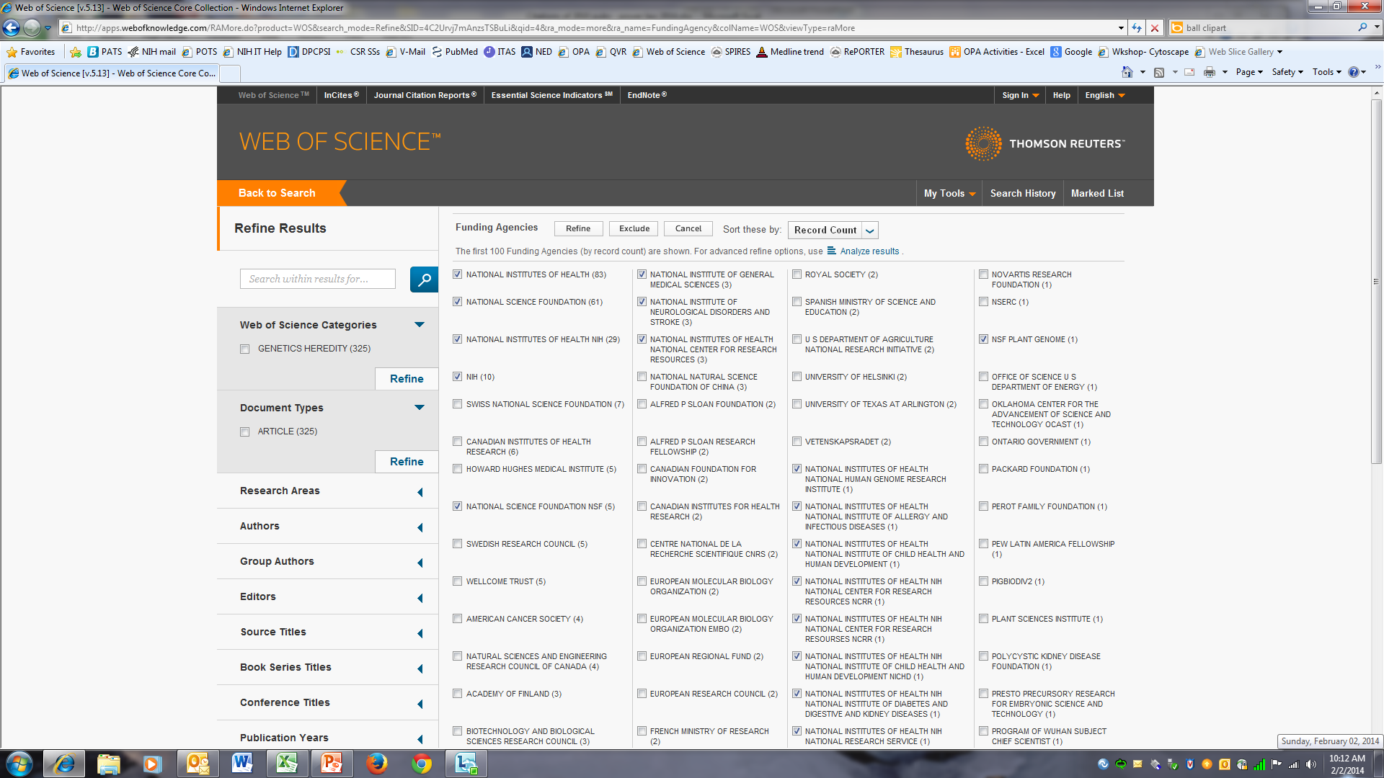

Slide 32
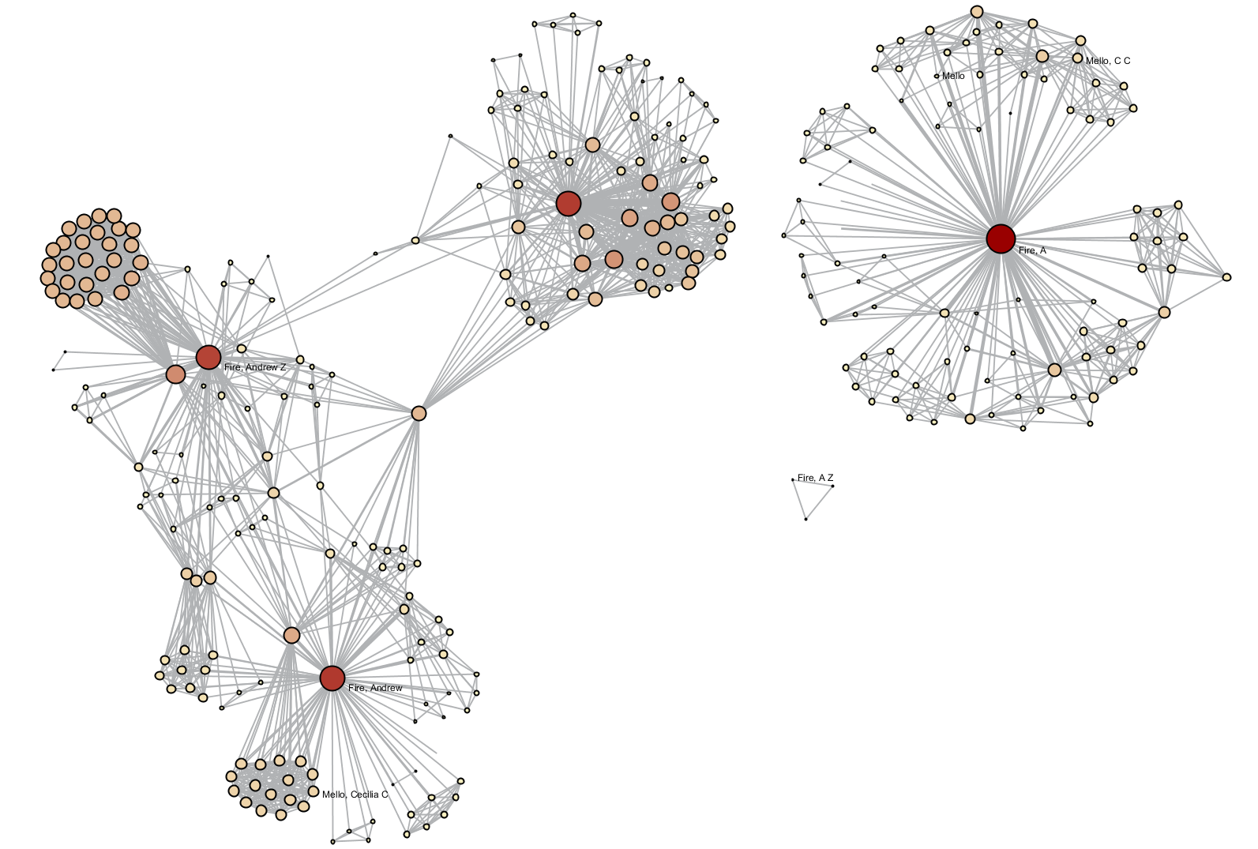
Ambiguous Names
Fire, A
Fire, Andrew Z
Fire, A Z
Fire and Mello
Fire, Andrew
Office of Portfolio Analysis

Slide 33
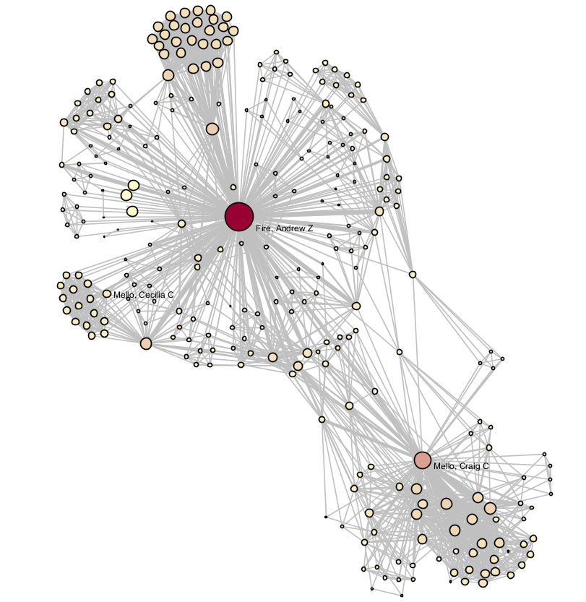
After disambiguation
Fire and Mello
Office of Portfolio Analysis

Slide 34
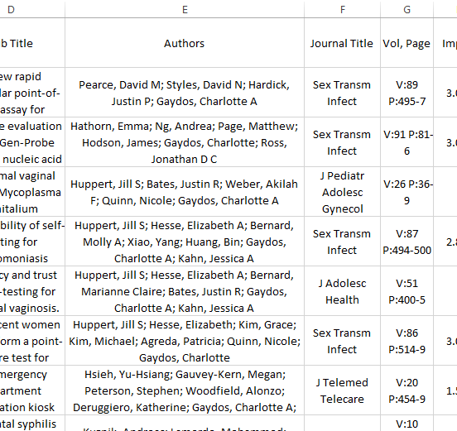
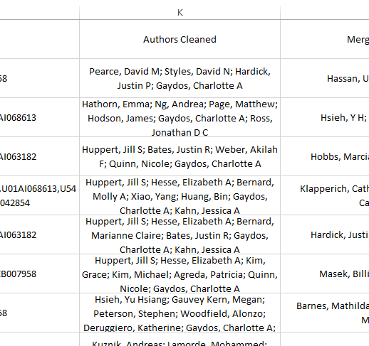
a tool that makes disambiguating a list of names easy
accepts outputs from a number of data sources i.e SPIRES, QVR biblio report, etc.
the only requirement is to have the list of names to disambiguate in one column
List of names to be disambiguated
List of disambiguated names
https://od.lexicalintelligence.com/iClean/
Notes:
iClean is a tool OPA developed to make name disambiguation easy. It accepts outputs from a number of data sources i.e SPIRES, QVR biblio report, etc. the only requirement is to have the list of names to disambiguate in one column. Here we can see a list of authors’ names exactly as it was downloaded from SPIRES. Each row is a different PMID, and we can see that author Gaydos appears as Gaydos, Charlotte A; Gaydos, Charlotte. iCLean creates a new column, and picks a unique way for each author, in this case: Gaydos, Charlotte A.

Slide 35
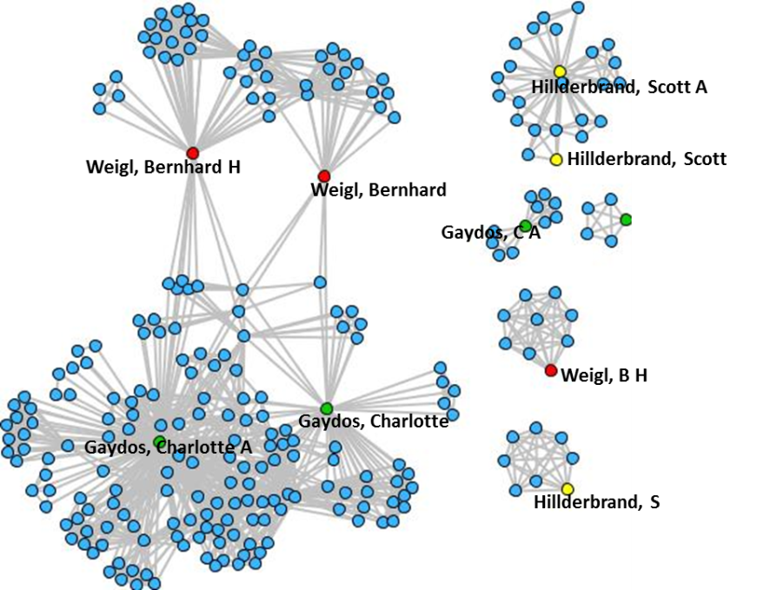
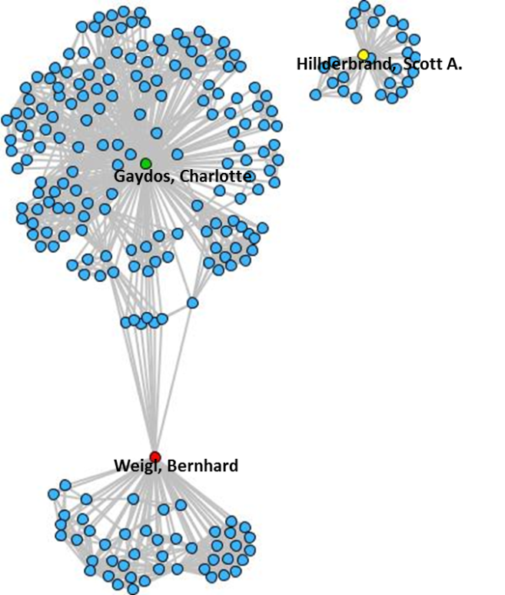
List of input names
Hilderbrand, S
Hilderbrand, Scott
Hilderbrand, Scott A
Weigl, B H
Weigl, Bernhard
Weigl, Bernhard H
Gaydos, C
Gaydos, C A
Gaydos, Charlotte
Gaydos, Charlotte A
List of disambiguated names
Hilderbrand, Scott A.
Weigl, Bernhard
Gaydos, Charlotte
Co-author network before name disambiguation
Co-author network after name disambiguation
Notes:
A practical example where you can use iClean, is in a co-author network. Each circle should represent one author, and each line connecting the authors, is a paper the 2 authors publish together.

Slide 36
Identify the tools
The Basics: Part Three
Office of Portfolio Analysis

Slide 37
What tools are you going to use?
Select the tool for the job, not the other way around
Sometimes the simplest tool is the right tool
Office of Portfolio Analysis

Slide 38
Bibliometric Analysis
iCite
CitNet Explorer
CiteSpace
Text Mining and Clustering
IN-SPIRE
Carrot2
Network Analysis
Sci2/Guess
Gephi
Cytoscape
NodeXL
Office of Portfolio Analysis

Slide 39
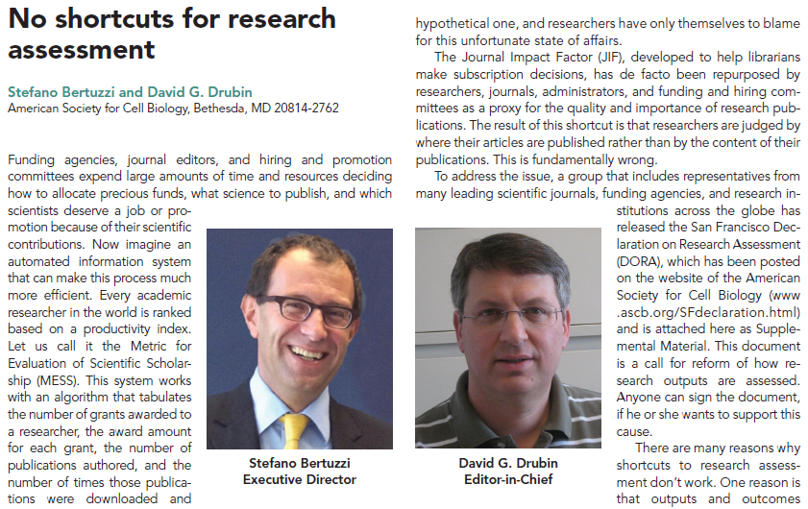
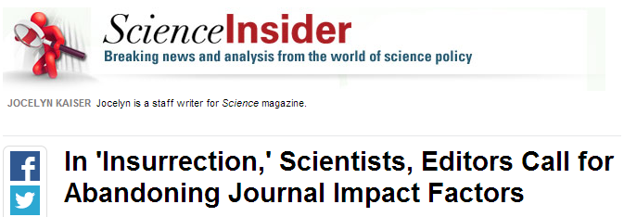
Abandoning Impact Factor: a growing consensus
Office of Portfolio Analysis

Slide 40
Relative Citation Ratio: how influential is an article?
Citations per year received by an article, normalized by:
Field
Year
NIH-funding
“How many citations per year compared to peer articles in the same field?”
Average = 1.0
2.0 = twice as many citations per year as expected
0.5 = half as many citations per year as expected

Slide 41
RCR: A scalable measure of influence well-correlated with expert opinion
RCR vs. Expert Review Scores

Slide 42
iCite: a bibliometrics dashboard for NIH staff
Random sample
of non-NIH axon
guidance papers
NIH-funded
investigator studying
axon guidance

Slide 43
Exercise: Analyzing a portfolio with iCite
Public iCite:
https://icite.od.nih.gov
Lower download limits (200 articles)
NIH-internal iCite:
http://icite-beta.od.nih.gov
High download limits (50,000)
Start from grants search in iSearch:
http://10.157.43.233:8080/iSearch

Slide 44
Text Mining and Clustering:IN-SPIRE
Developed by PNNL (Pacific Northwest National Laboratory)
Clusters free text and provides a useful overview of the scientific landscape of a portfolio
Free for government use
http://in-spire.pnnl.gov/
Office of Portfolio Analysis

Slide 45
IN-SPIRE Text Processing
Extract text from documents
Create a mathematical vector for each document
Organize according to key topics
Cluster the document vectors in n-space
Present each document as a “docustar” where proximity suggests similar themes
Project the n-space clusters into a 2-D visualization
Office of Portfolio Analysis

Slide 46
IN-SPIRE Analysis and Visualization
Analysis
Thematic distribution by various metadata
Query relationships and overlap
Targeted search
Time slicing
Informed exploration and discovery
Visualization
Galaxy View permits intuitive interaction to explore the dataset
Theme View provides a 3-D representation of clusters
Office of Portfolio Analysis

Slide 47
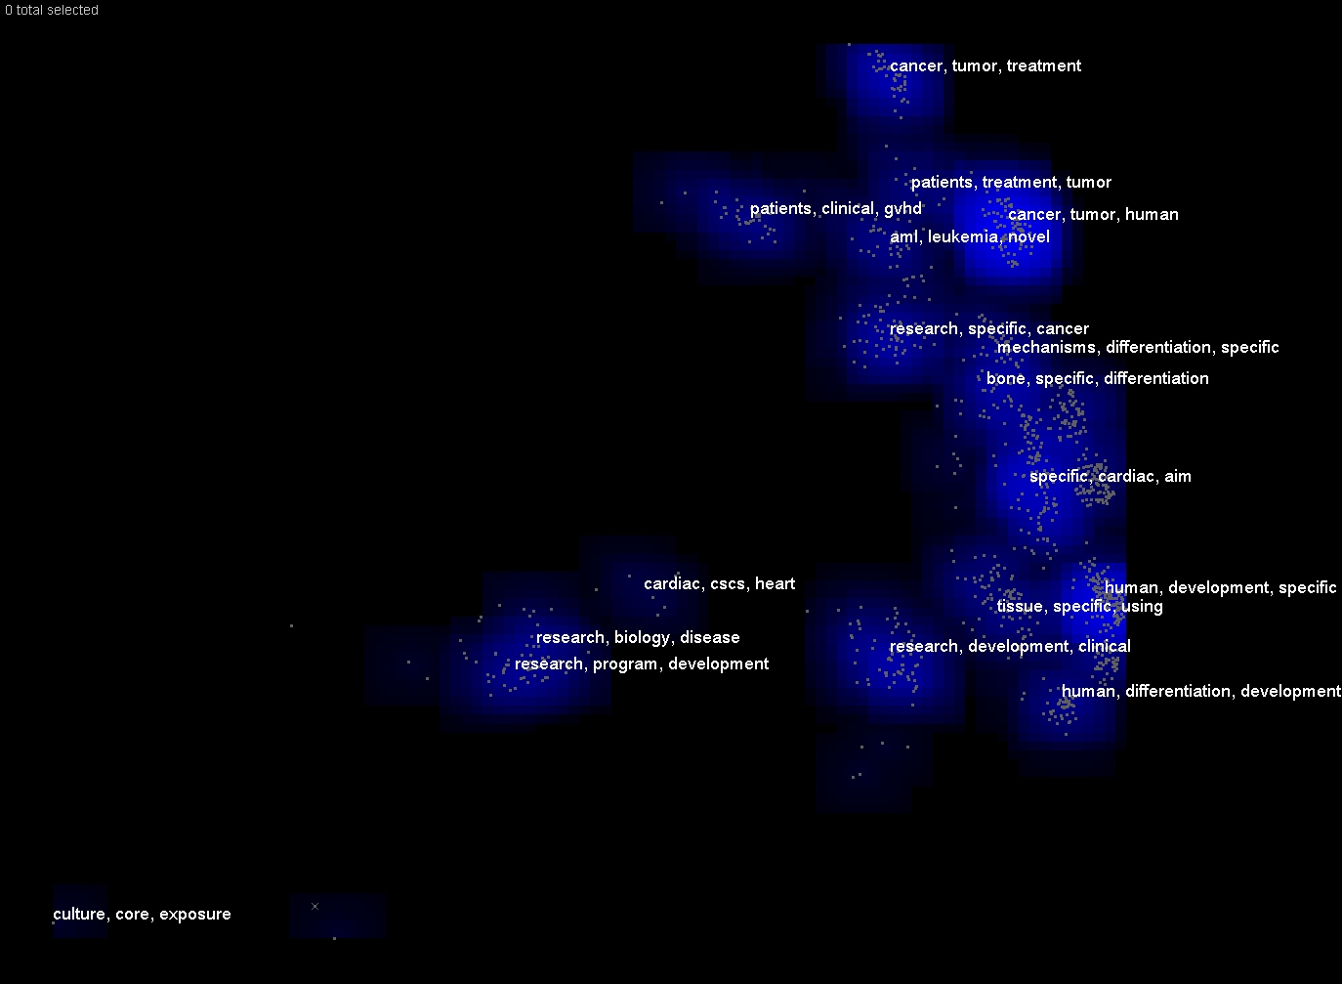
Galaxy View: 2013 “Stem Cell”

Slide 48
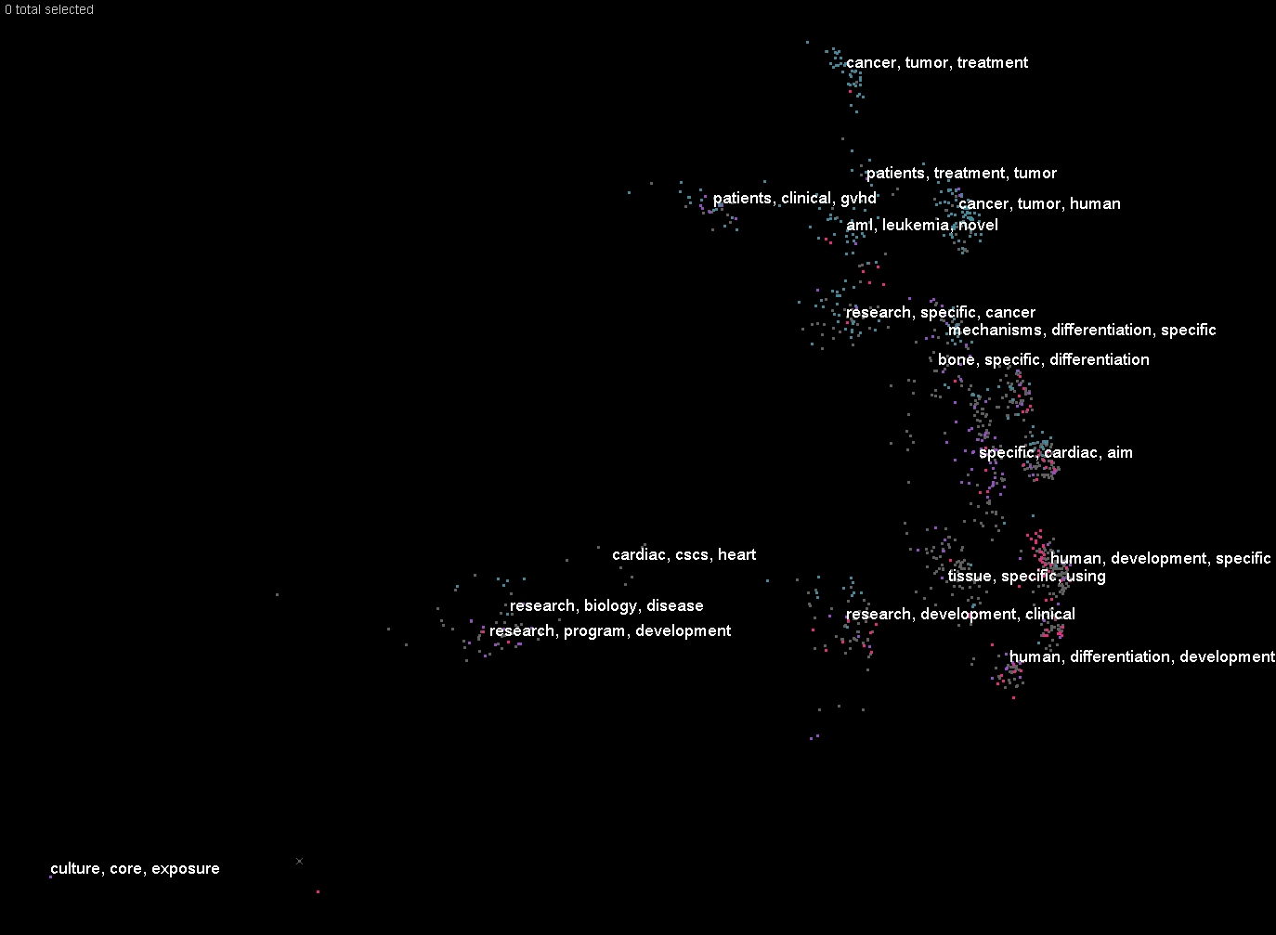
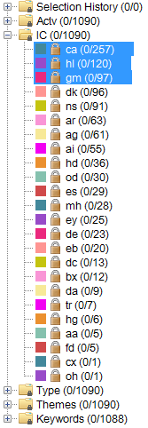
Highlight Groups

Slide 49
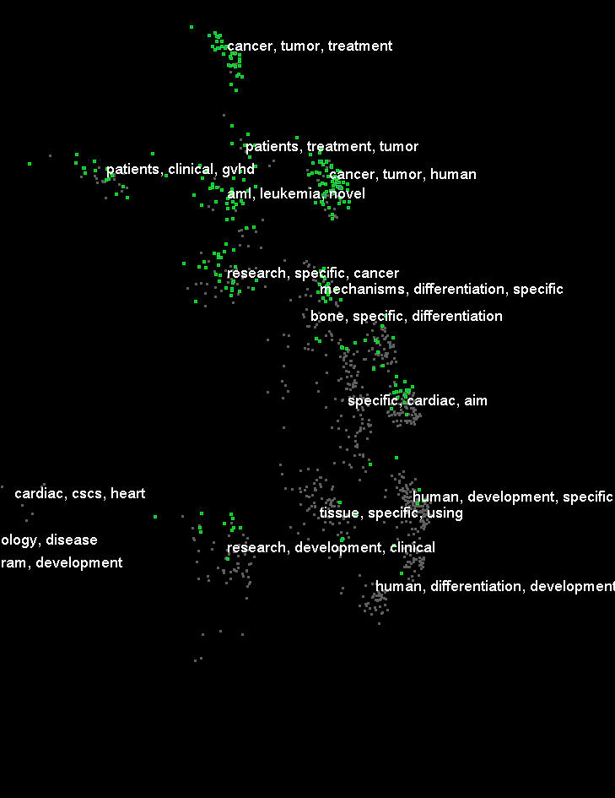
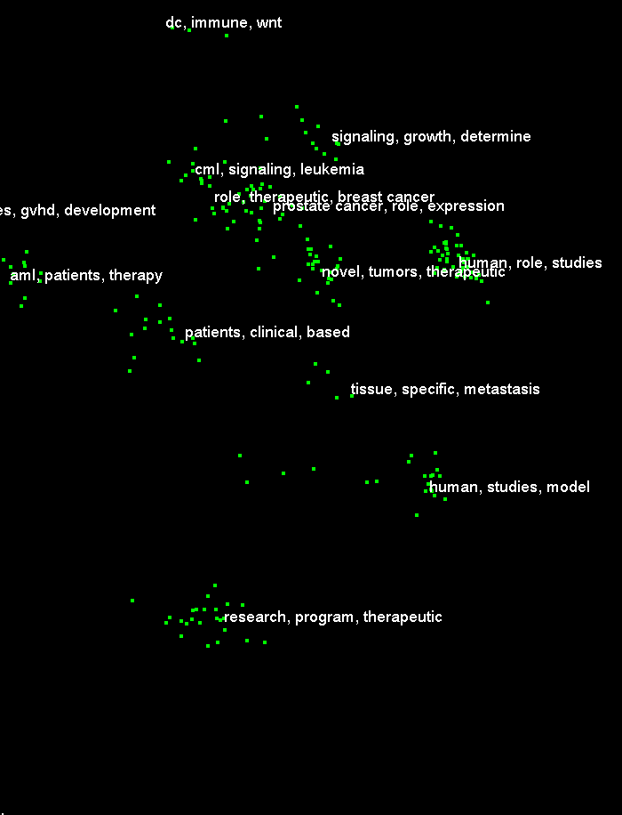
Drill Down

Slide 50
ThemeView Classic
291 Projects
2009

Slide 51
Text Mining and Clustering: Carrot
Carrot² is a framework for building document clustering engines
Two specialized document clustering algorithms
Ready-to-use components for fetching search results from various sources such as public search engines
http://carrotsearch.com/opensource-overview
http://search.carrot2.org/stable/search
Office of Portfolio Analysis

Slide 52
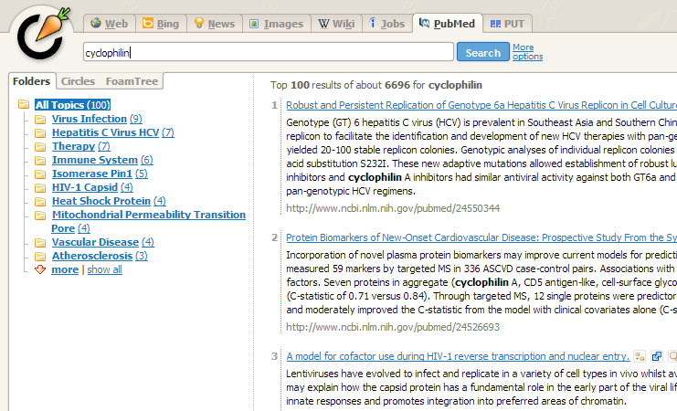
Office of Portfolio Analysis

Slide 53
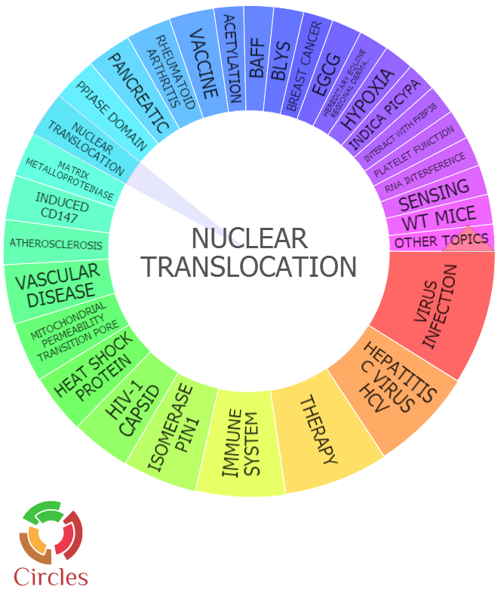
Office of Portfolio Analysis

Slide 54
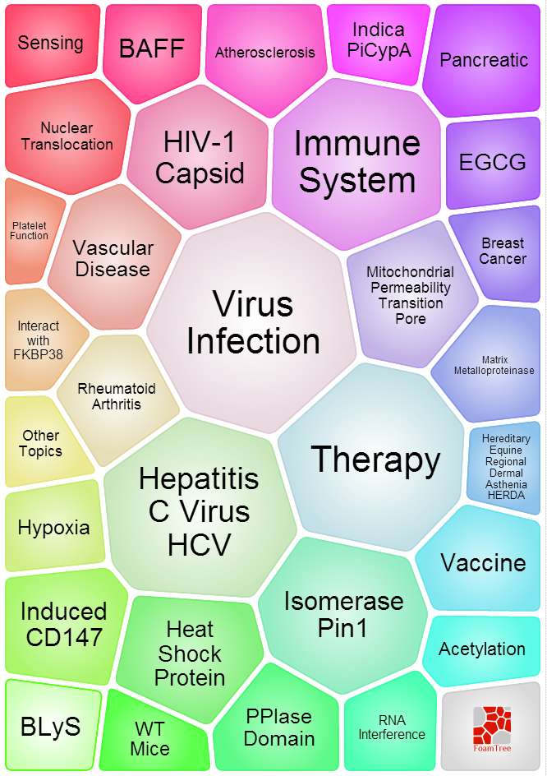
Office of Portfolio Analysis

Slide 55
Network Analysis Tools
Sci2
Supports the temporal, topical and network analysis, and visualization of scholarly datasets
Free software
https://sci2.cns.iu.edu/user/index.php
Office of Portfolio Analysis

Slide 56
Is there collaboration in my field?
USA
Europe
Japan
FY09 Co-authorship Networks
Notes:
OPA analysis of 38 Metabolomics Centers in the US, most of which receive funding from NIH (~$70M in 2010)
These Centers have overlapping goals, yet operated in isolation with little coordination or collaboration
Portfolio analysis shaped a new Metabolomics RFA aimed at improving coordination and leveraging existing resources

Slide 57
Networks Evolve over Time
Co-author network of the portfolio of grants belonging to a particular PO
evolving with time
2009
2009-2010
2009-2011
2009-2012
2009-2013
2009-2014
The color & size of the nodes were adjusted to reflect degree
Notes:
Here we can see a the same co-author network from the previous slides evolving with time CLICK Seven TIMES. Also, in this network we can see that the nodes’ size and color CLICK has been adjusted to reflect the level of connectedness of the Pis, the larger the number of connections, the bigger and darker the node’s size and color. From this graph we can extract information like who are the PIs best connected, and potential key players in this portfolio of grants, as well as if the degree of collaboration has changed with time.

Slide 58
Final points
Office of Portfolio Analysis

Slide 59
Take contemporaneous notes while you are carrying your analysis
Take time to define the portfolio
Present your results in the context of the question that you posed
Make the visualizations count
Simplify, don’t complicate
Clean your data, clean your data, clean your data!
Office of Portfolio Analysis

Slide 60
Contact Us
NIH
https://list.nih.gov/cgi-bin/wa.exe?A0=portfolio_analysis
Office of Portfolio Analysis

